Slide 1
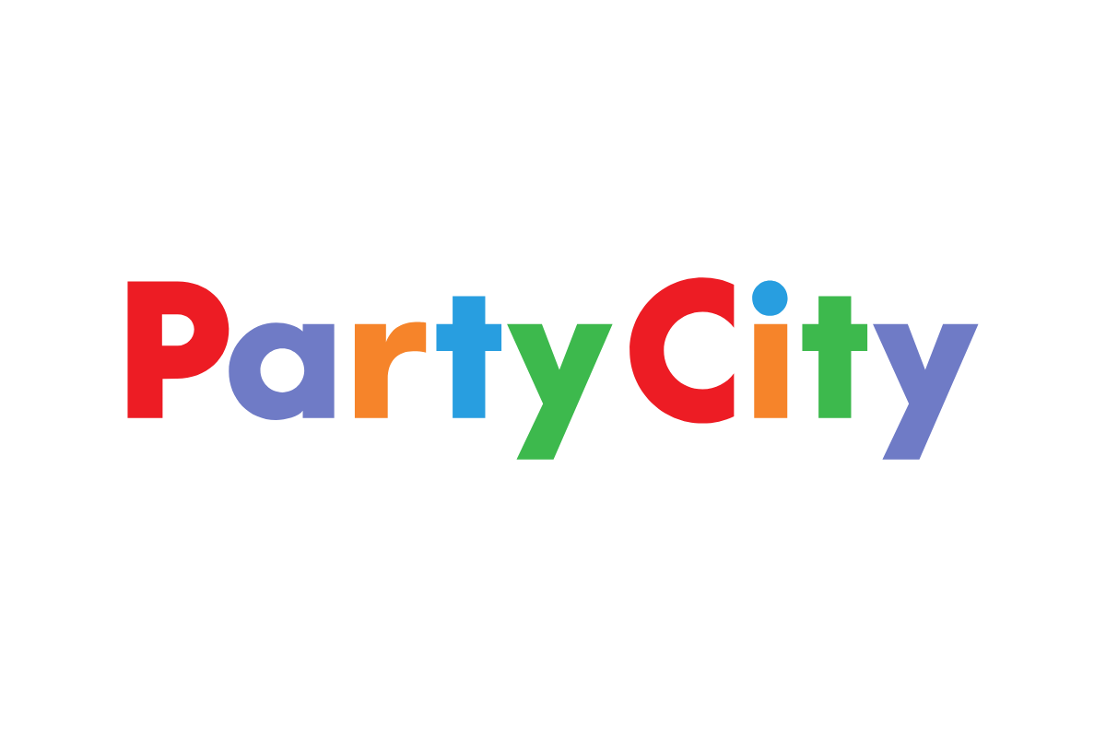
Strategic Renewal Blueprint
Team 7: Kayley, Mike, Naz & Valeria
CAP 604
Notes:
Mike

Slide 2
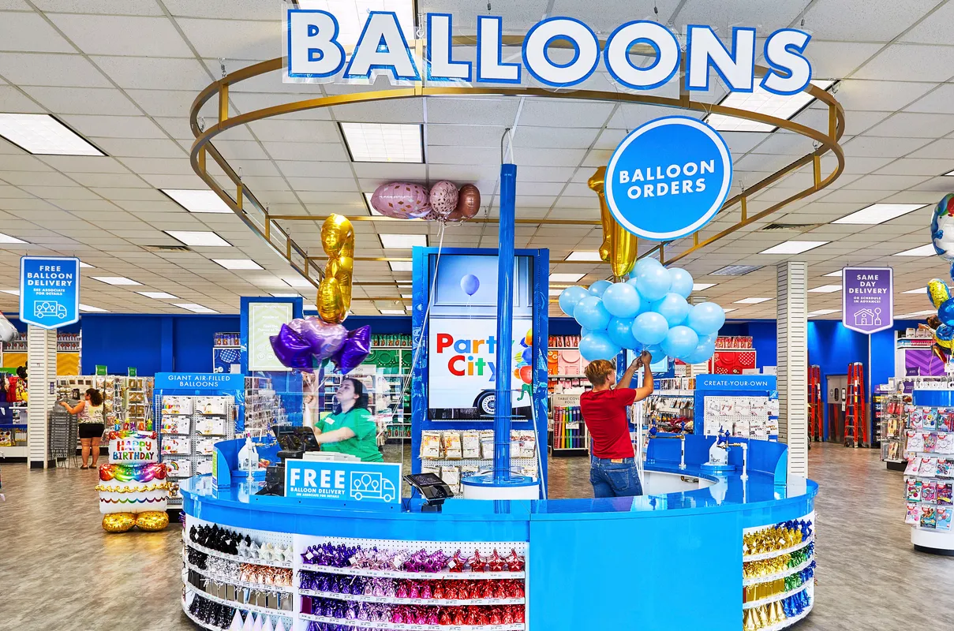
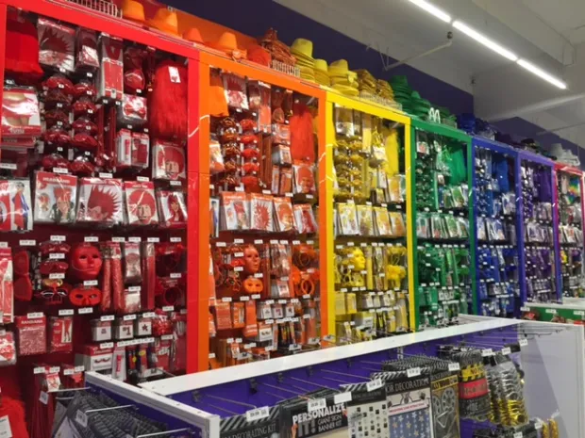

Agenda
Company Background
Competitive Analysis
The Current Situation
Renewal Approach in Practice
Renewal Blueprint Recommendation
Tips and Traps
The Leadership Role Recommendation
Q&A
Notes:
Mike

Slide 3
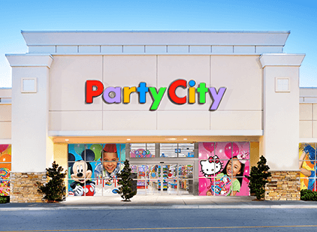
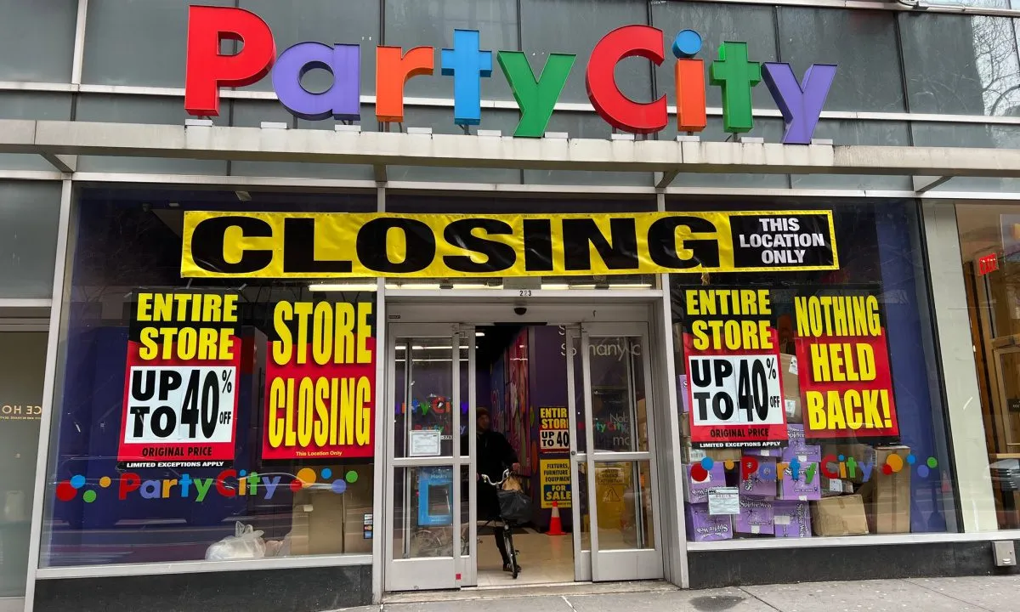
Company Background
Established in 1986 by Steve Mandell
Interim CEO (2023): Sean Thompson
Purpose: To inspire joy by making it an easy experience to create memories.
Operates more than 750 company-owned and franchised stores
The largest vertically integrated designer, manufacturer, distributor, and retailer of party goods in North America.
Notes:
Kayley

Slide 4
Company Timeline
1990’s: Location expansion and franchising operations
2000’s: Amscan acquired and Partycity.com launched
2011: Enters the Canadian Market through acquisition of retailer “Party Packagers”
2015: Party City Holdco goes public on the NYSE (PRTY)
2018: Toy City pop-stores formed to capitalize on Toys “R” Us closures
2023: Filed for bankruptcy, NYSE halted trade of PRTY stock
2024: Focusing on coming back from bankruptcy with a consumer-centric approach
Notes:
Kayley

Slide 5




Competitor Strength Analysis
Diverse and large product range - including seasonal items Offers DIY party solutions Ample store network Strong brand recognition Loyal customer base | Value-oriented pricing model Wide variety of party supply product options Appeals to budget-conscious consumers Can be a one-stop shop | One-stop shopping experience Offers a large selection of products - household, groceries, and party supplies Appeals to a wide customer base Strong brand recognition | Offers exclusive merchandise Is an immersive and interactive shopping experience Conveniently located in high-traffic areas High consumer engagement with contests and events
Notes:
Kayley

Slide 6
Swot Analysis
Strengths: The company offers a vast selection of products for various occasions, such as birthdays, weddings, graduations, and holidays. | Weaknesses: Dependence on seasonal sales. The majority of the company's sales come from the Halloween and Christmas seasons, with a significant portion of the rest of the year being slow in comparison.
Opportunities: Create more partnerships, the company has a Licensing agreement with Disney to sell party supplies and decorations featuring characters from popular Disney movies and television shows. | Threats: Customers are increasingly shopping online, and the convenience of online shopping has made it challenging for traditional brick-and-mortar retailers to compete.
Notes:
V- swot analysis
strengths:
The company offers a vast selection of products for various occasions, such as birthdays, weddings, graduations, and holidays. It represents a one-stop shop for anything celebration related.
Weaknesses:
Dependence on seasonal sales. The majority of the company's sales come from the Halloween and Christmas seasons, with a significant portion of the rest of the year being slow in comparison.
This dependence on seasonal sales can create challenges for Party City in terms of managing inventory, staffing, and cash flow. Moreover, Party City has faced challenges related to its supply chain and logistics.
Opportunities:
Create more partnerships. One of the most significant partnerships of Party City is with Disney. The company has a Licensing agreement with Disney to sell party supplies and decorations featuring characters from popular Disney movies and television shows.
Threats:
Customers are increasingly shopping online, and the convenience of online shopping has made it challenging for traditional brick-and-mortar retailers to compete. Moreover, online retailers can offer lower prices and a more extensive selection of products, making it challenging for PartyCity to maintain its market share.

Slide 7
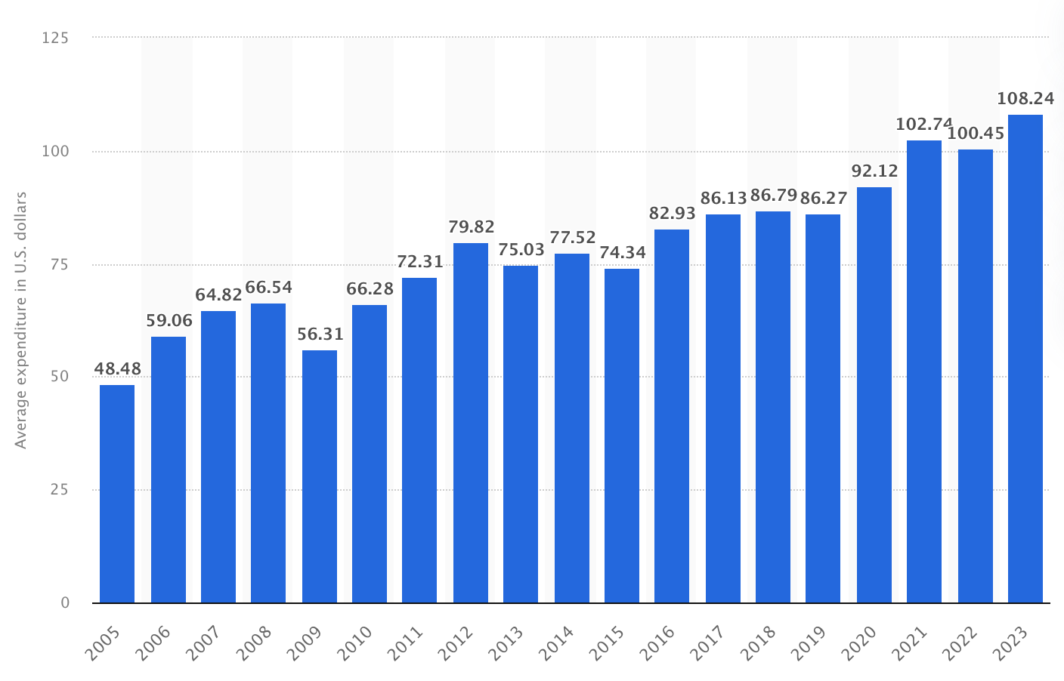
Celebrations Industry
US retail and wholesale consumer products firms have been experiencing an uptick in financial risk (market leverage)
Seasonal specialty businesses are particularly under duress as they need cash to fund inventory in advance of peak seasons
Inflation prevailing post covid and changes in consumer spending
Expected average consumer expenditure on Halloween-related items in the United States from 2005 to 2023
Notes:
V- celebrations industry
This chart represents Expected average consumer expenditure on Halloween-related items in the United States from 2005 to 2023
Party City is part of the Retail Goods industry within the celebrations segment.
According to the National Retail Federation’s annual survey conducted by Prosper Insights & Analytics, total Halloween spending was expected to reach a record $12.2 billion, exceeding 2022’s record of $10.6 billion.
After Covid-19, the US retail and wholesale consumer products firms have been experiencing an uptick in financial risk (market leverage). Seasonal specialty businesses are particularly under duress as they need cash to fund inventory in advance of peak seasons. Inflation prevailing post covid and changes in consumer spending, highly leveraged and cash-intensive firms faced an elevated risk of bankruptcy.
According to Statista, The Us Retail Goods stores have the greatest influx in sales during the halloween season due to large consumer spending for this time of the year. The chart below shows the expected average consumer expenditure on Halloween-related items in the United States from 2005 to 2023
Party city has made note of this and has ensured they have the most promotions and advertising during this time of the year

Slide 8
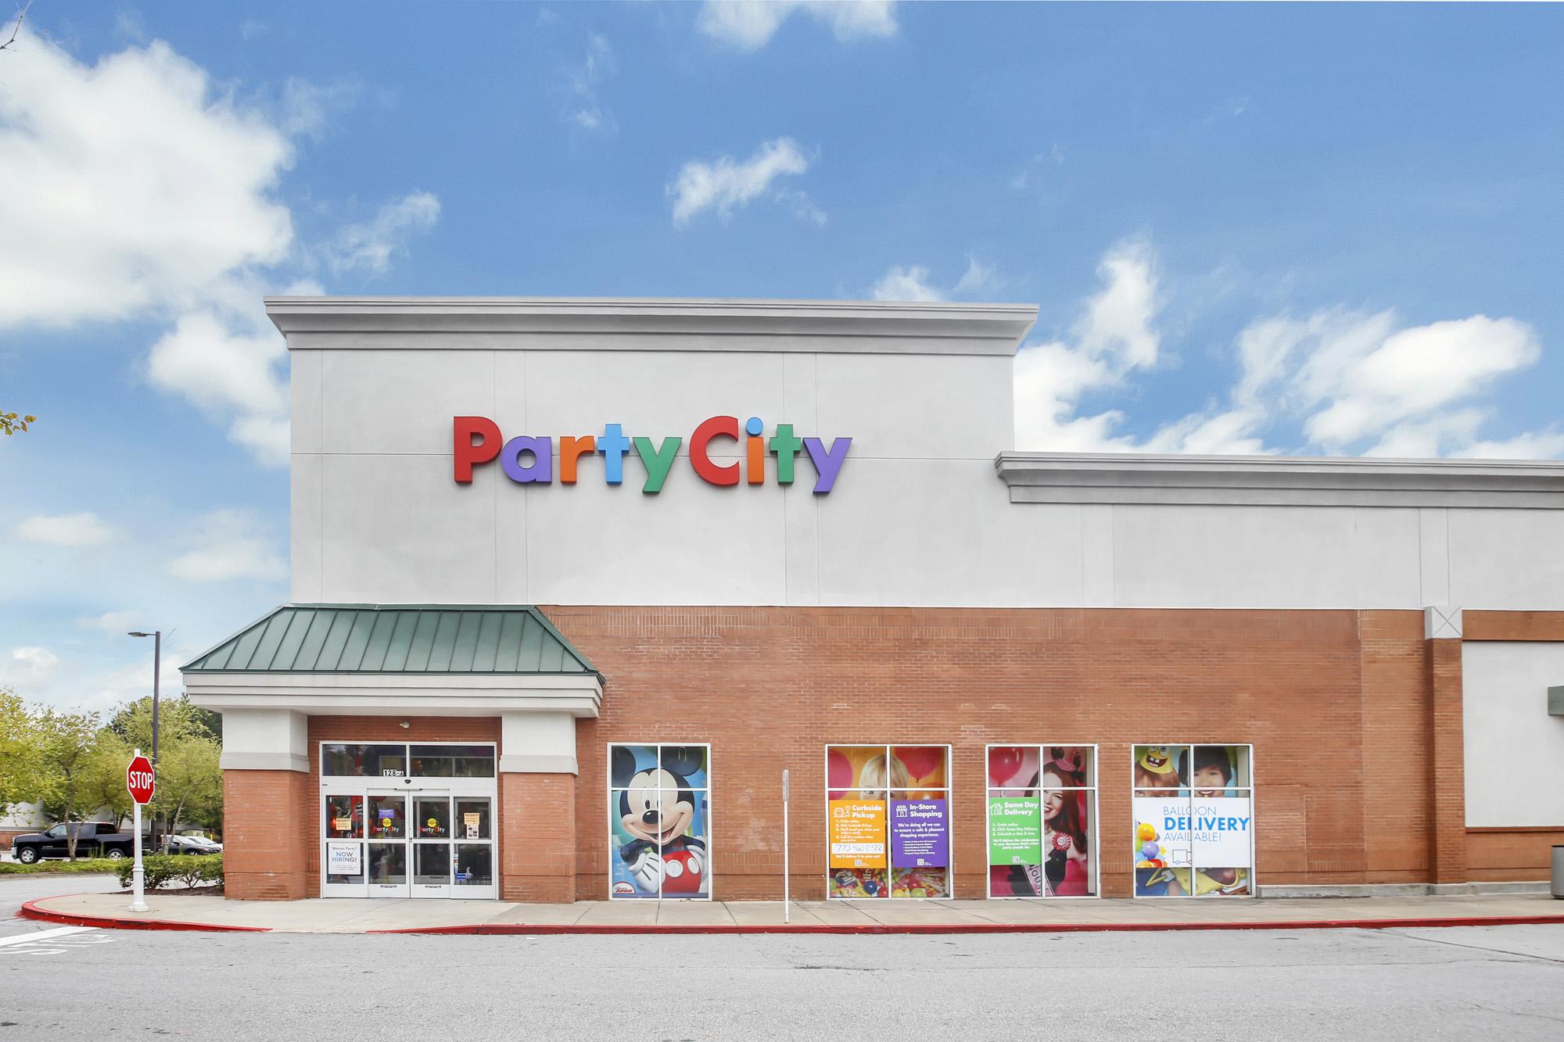
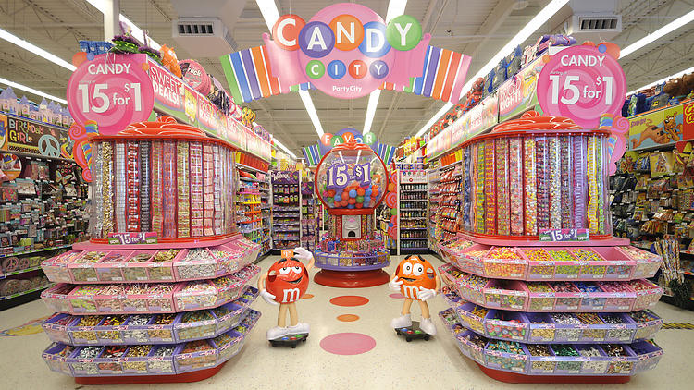
Challenges
The company reported losses every year from 2019 to 2022
Growing competition from e-commerce sites and pop-up concepts like Spirit Halloween
Online retailers offer lower prices and a more extensive selection of products, making it challenging for Party City to maintain its market share
Notes:
Valeria-challenges
Party city has been struggling through several challenges which qualified the company for a renewal strategy
The company reported losses every year from 2019 to 2022.
Online retailers offer lower prices and a more extensive selection of products, making it challenging for Party City to maintain its market share
After filing for bankruptcy in 2023, had stumbled in the face of growing competition from e-commerce sites and pop-up concepts like Spirit Halloween.
Currently, completed its restructuring process and emerged from Chapter 11 bankruptcy protection financially stronger and well-positioned for the future
The party goods retailer said it eliminated nearly $1 billion in debt, enhanced its liquidity and optimized its Party City store portfolio by having negotiated improved lease terms and exited less-productive stores.The company will move forward with nearly 800 Party City locations nationwide.
U.S. Bankruptcy Court for the Southern District of Texas approved in september Party city’s plan to emerge with a new exit asset-based revolving credit facility of $562 million and a $75 million new money investment to fund go-forward operations and distributions under the plan.
I will now hand it over to mike for the renewal approach in practice

Slide 9
Renewal Approach in Practice
Innovation
Culture
Encourage innovation by investing in R&D and creative product offerings.
Create a culture of innovation and servant leadership that prioritizes the customer.
Organization
Information
Restructure organization to foster agility and responsiveness to market changes.
Leadership
Integrate comprehensive data analytics strategy.
Develop leadership capabilities at all levels of the organization.
Notes:
mikey

Slide 10

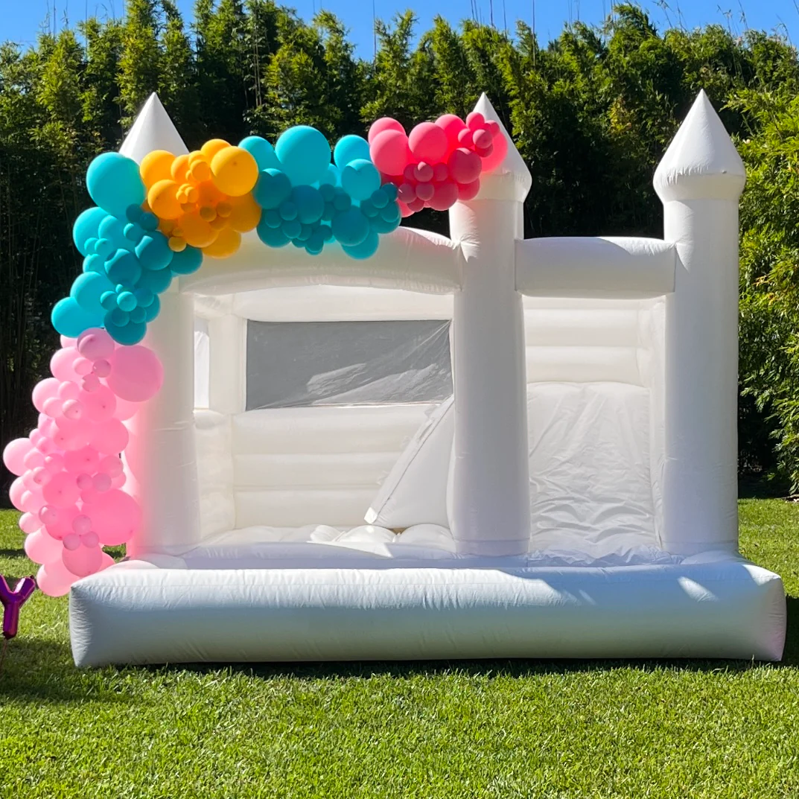
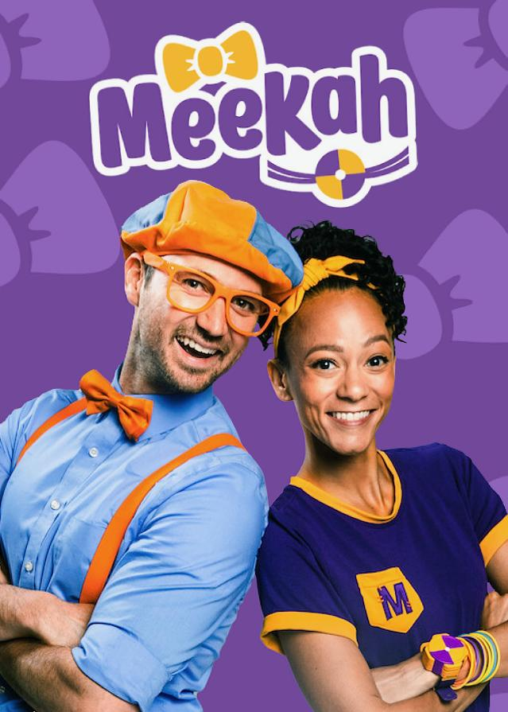
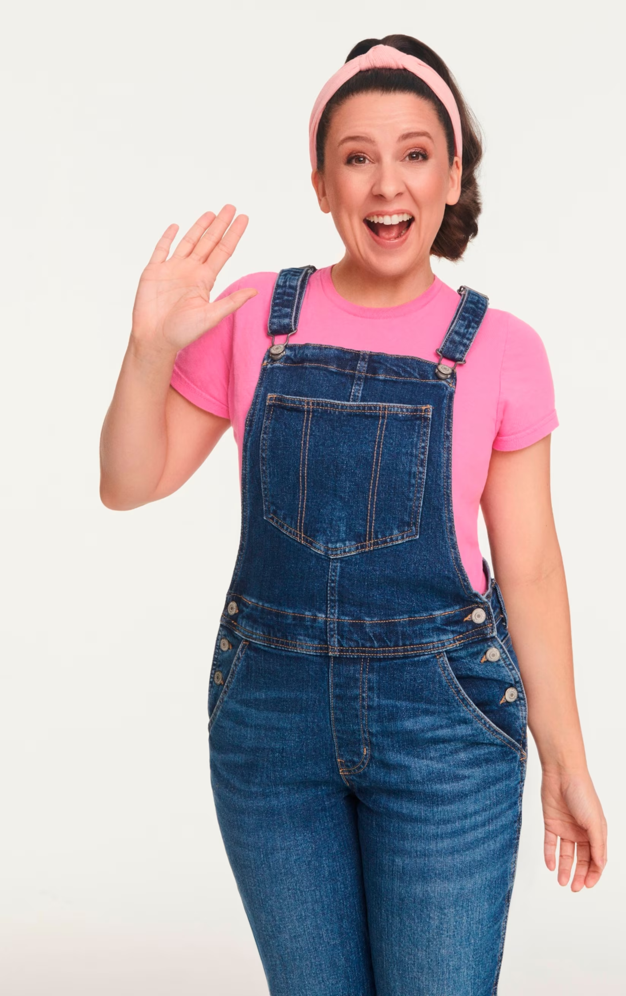
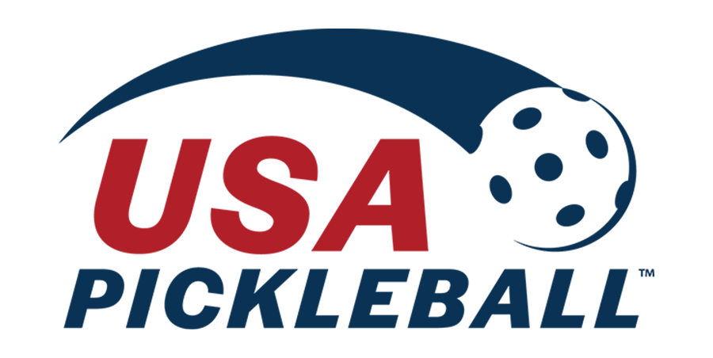
Renewal Strategy Recommendation
Implement the Adaptive strategy approach to explore partnerships with other businesses, expand its product range and reach new customers
Businesses | Sports Associations | Media Channels
Notes:
Valeria-renewal strategy recommendation
We recommend Party City implement the adaptive strategy approach to explore partnerships with other businesses to expand its product range and reach new customers. Their most profitable partnership is with Disney.
They could extend partnerships to popular children's YouTube channels like Ms Rache, meekay blippi, video games or shows on Netflix. Additionally, they should partner with other sports associations like the USTA for tennis or the US Pickleball Association since their NFL and NBA partnerships are so popular.
On the other hand, the company can partner with event planning companies, catering businesses, or party rental services to offer a one-stop shop for customers planning events. In the e-commerce segment of their business, the company can invest in marketing strategies such as search engine optimization, social media advertising, and email marketing to attract new customers and retain existing ones.
With these new alternatives in line they can help to migitigate the sales polarity throughout the seasons
Now kayley will continue the recommendation for the renewal strategy

Slide 11
Renewal Strategy Recommendation
Create interactive & engaging consumer experiences through every touch point.
Strategic promotion of App benefits: Highlight selling convenience factors of App; Free shipping, curbside delivery, same-day delivery, etc.
Creating the Ultimate Party Experience: Social media campaigns, photo booth promotion stations, AI-guided costume selection, holiday-themed events
Engaging young consumers and parents: Small product giveaways, similar to Publix cookies
Holiday-themed promotions: Host holiday-themed promotions and events, such as costume contests related to promotional campaigns, during peak seasons.
Notes:
Kayley
Companies that lead in customer experience outperform laggards by 80% (Forbes)
Strategic Promotion of App Benefits: Utilize the current app to highlight its convenience selling factors, such as curbside pickup, same-day delivery, reduced delivery costs, and competitive product pricing, to attract consumers back to the store.
Creating an Ultimate Party Experience: Ensure that Party City stores and subsidiary stores evoke the excitement of a party or celebration. Utilize interactive experiences, such as technological resources, party planning contests on the app, photo booth stations, AI-guided costume selection, and holiday-themed events like costume contests, to enhance consumer engagement and make the shopping experience enjoyable for everyone.
Involving Consumers in Product Selection: Involve consumers in the process of selecting or designing exclusive merchandise to be sold in stores. This not only builds consumer relationships but also aids in understanding consumer preferences, fostering loyalty and relevance.
Engaging Young Consumers and Parents: Implement strategies to engage young consumers and parents, such as giving away balloons or small products to children, akin to how Publix gives away cookies. This small gesture can create a memorable and positive experience for families, increasing brand loyalty and foot traffic to the stores.
Holiday-themed Promotions: Host holiday-themed promotions and events, such as costume contests related to promotional campaigns, during peak seasons. This creates excitement around Party City stores and reinforces their relevance, encouraging consumers to visit and make purchases.

Slide 12
Implementation Plan
Adaptive Strategy Approach
Partner with Profitable Businesses:
  Leverage existing successful partnerships (e.g., Disney) to expand product offerings.
  Explore collaborations with popular YouTube channels and streaming platforms (e.g., Netflix).
  Extend Party City’s reach to new customer segments.
App Promotion
Emphasize Convenience Selling:
  App perks: Easy ordering and delivery.
  Personalized recommendations based on past purchases.
  Exclusive discounts for valued customers.
Dedicated Innovation Labs
Explore New Business Opportunities:
  Identify disruptive technologies.
  Test innovative concepts.
  Learn from both successes and failures.
Matrix Organizational Structure
Cross-Functional Collaboration:
  Restructure Party City for agility.
  Enable swift decision-making.
Empower Creative Problem-Solving:
  Encourage employees to address customer needs efficiently.
  Foster autonomy in finding solutions.
Notes:
Cultural Transformation
Embrace Change and Innovation
Reward Entrepreneurial Spirit:
Cultivate a culture of adaptability and innovation.
Recognize and celebrate contributions.
Strong Leadership
Communicate the Vision
Leadership Development Programs:
Equip leaders to navigate transformative phases.
Ensure alignment with the renewal strategy.

Slide 13
Tips
Turning the Page: Vision for Renewal:
Going beyond efficiency moves and creating a vision
A clear vision inspires employees, aligns efforts, and provides a roadmap for sustainable success.
Support Foundational Innovation:
Innovating across multiple dimensions
Diversifying revenue streams, exploring partnerships, and investing in R&D
Inspire Hope:
Cultivating Positivity by shifting organizational culture toward optimism and resilience
Create a long-term vision, give employees sense of purpose and direction
Quick wins demonstrates progress and builds confidence
Notes:
Turning the Page: Vision for Renewal:
Go beyond efficiency moves and creating a vision for growth and innovation is crucial.
Party City needs to reimagine its future beyond survival mode.
Impact: A clear vision inspires employees, aligns efforts, and provides a roadmap for sustainable success.
Support Foundational Innovation:
Innovating across multiple dimensions of the business model is necessary. Dimensions like product, process, culture, business model
Simply introducing new products within the existing framework may not be sufficient.
Impact: Diversifying revenue streams, exploring partnerships, and investing in R&D can position Party City for long-term prosperity.
Inspire Hope:
Hardship often leads to pessimism and insecurity among employees. Cultivating Positivity by shifting organizational culture toward optimism and resilience.
Impact: Employees become more motivated, collaborative, and willing to contribute to the company’s success.
fostering commitment and dedication.
Quick Wins: Impact: Celebrating small victories boosts morale, encourages perseverance, and reinforces the belief that positive change is possible

Slide 14
Traps
Burning the Furniture:
Continuously cutting costs without considering the future can harm Party City
Impact: The company risks sacrificing long-term viability for short-term gains
Legacy Thinking:
Holding onto outdated assumptions and practices limits Party City’s ability to adapt.
Staying too close to the core business stifles innovation.
This approach becomes ineffective, hindering growth and agility.
Notes:
Burning the Furniture:
Continuously cutting costs without considering the future can harm Party City.
Overemphasis on efficiency may neglect strategic investments.
Impact: The company risks sacrificing long-term viability for short-term gains.
Impact

Slide 15
Leadership Role Recommendation
The Disrupter: Reviews the diagnosis and segmentation on an ongoing basis to protect the organization from becoming rigid and to change approaches when necessary.
Proactive decision-making and strategic adjustments
Avoid ignoring changing consumer trends, competitor actions, and opportunities for sustained competitive advantage
Align with market demands and customer expectations
Foster a culture of innovation and experimentation
Handle uncertainty, drive resilience, and maintain relevance
Notes:
The disrupter allows for Party City to gain its relevance back and ensure that consumers recognize the convenience of the brand, how it will be there through every milestone someone deems worth celebrating, and to engage with customers on a deeper than the surface levels because consumer behaviors, trends, and preferences will be understood that much more.
Continuous review of market trends, consumer preferences, and competitive dynamics
Proactive decision-making and strategic adjustments
Avoidance of ignoring changing consumer trends, competitor actions, and opportunities for sustained competitive advantage
Adjusting product offerings and refining marketing strategies
Alignment with market demands and customer expectations
Fostering a culture of innovation and experimentation
Handling uncertainty, driving resilience, and maintaining relevance

Slide 16
Thanks!
Any Questions?

Slide 17
Sources
https://corporate.partycity.com/company-profile
https://investor.partycity.com/company-profile#:~:text=We%20inspire%20joy%20by%20making%20it%20easy%20to%20create%20unforgettable%20memories.
https://investors.partycity.com/corporate-governance/board-of-directors#:~:text=Director-,Sean%20C.,Commercial%20Officer%20in%20November%202022.
https://www.gbclawgroup.com/blog/how-party-city-entered-and-emerged-from-bankruptcy/#:~:text=After%20the%20restructuring%20plan%20was,Thompson%20in%20an%20interim%20capacity.
https://www.wsj.com/video/series/news-explainers/how-party-citys-party-ended-what-went-wrong/3EBB01DC-658D-4855-AF54-41C4039EB7F4
https://www.scrapehero.com/location-reports/Party%20City-USA/
https://www-statista-com.ezproxy.rollins.edu/statistics/274295/americans-planned-expenditure-on-halloween-related-items/
https://nrf.com/research-insights/holiday-data-and-trends/halloween#:~:text=Total%20Halloween%20spending%20was%20expected,conducted%20by%20Prosper%20Insights%20%26%20Analytics.
https://www.forbes.com/sites/qai/2023/01/23/the-party-is-over-party-city-files-for-chapter-11-bankruptcy/?sh=312b9a92740c
https://www.moodysanalytics.com/articles/pa/2023/is-the-party-over-for-highly-leveraged-seasonal-retailers
https://dcf.fm/blogs/blog/prty-history-mission-ownership
https://www.partycity.com/apps.html

